Slide 1

System Design & Analysis
PHASE two
2.7.2004

Slide 2
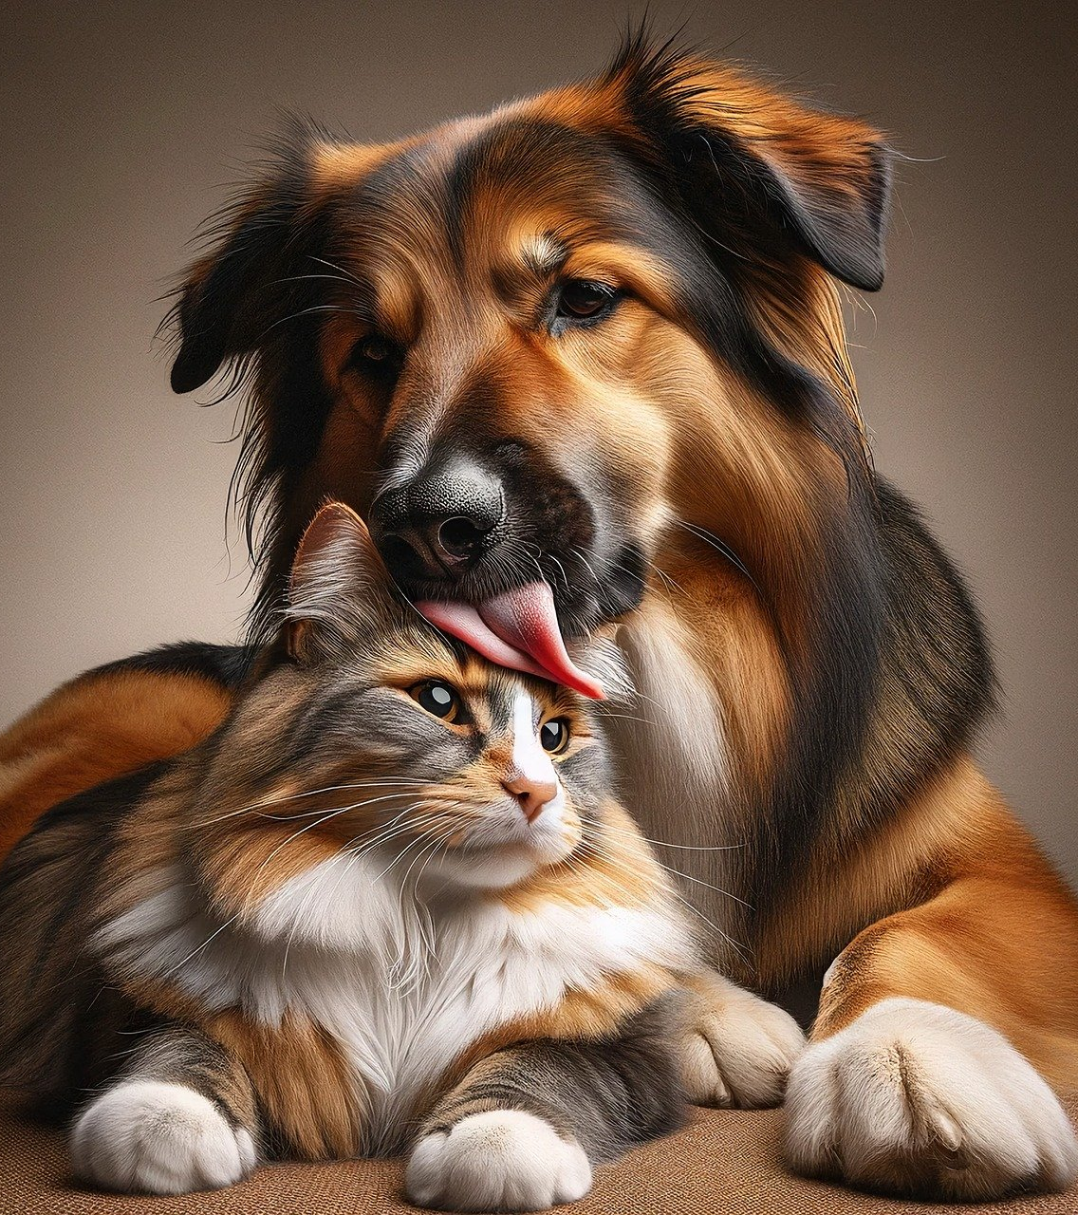
Catch phrase (in matt’s code)
PET NAMER
Would you like help picking a name for your pet?
Simply upload a picture and we’ll recommend a few different names for you!

Slide 3
LANDING PAGE
The first page seen if the domain was www.petnamer.com
Greeted by adorable animals
Create an account in order to be able to save name suggestions

Slide 4
Upload a pet pic
In order to receive pet name suggestions a user will need to upload a picture of their pet

Slide 5
Pet name suggestion page
A list of suggestions is returned

Slide 6
Account page
If any name suggestions are saved they will be here
The ability to update your account is also here

Slide 7

USER INTERFACE
X

Slide 8
x
Landing page with account creation
Picture upload screen
Picture recognition response
Name suggestions from designated databases based on the animal and obvious features
Ability to save favorite names to account database

Slide 9

x
After a client uploads a picture of their pet, our image recognition will be able to determine what kind of animal it is, then recommend names based off this information and a couple of other factors such as the animal’s coloring.

Slide 10
x
VSCode IDE
Vue
HTML
CSS
JavaScript

Slide 11

x
x
11

Slide 12

x
CURRENTLY RESEARCHING
We need an API for animal photo recognition, here’s what we are looking at possibly implementing:
Amazon Rekognition
Imagga
The Dog API
Vision AI
KerasCV

Slide 13
x
VSCode IDE
Python 3.11.8
Django
PostgreSQL

Slide 14
Timeline & milestones
Phase 1 | Phase 2 | Phase 3 | Phase 4
February 7 | March 6 | April 10 | May 1
PROJECT SELECTED | FRONTEND DEVELOPMENT | BACKEND DEVELOPMENT | TESTING & ADJUSTMENT

Slide 15
THANK YOU
Team 1: Phase Two

